Slide 1
The fuel manufacturing industry: a strategic asset that the EU cannot afford to lose
Emanuela Sardellitti
Advocacy Strategy Senior Executive
22 – 23 April 2026
Clean Energy & Mobility Summit 2026

Slide 2
Outlook
Who are we
The fuel manufacturing industry: a strategic asset that the EU cannot afford to lose
How a credible long-term transition looks like

Slide 3
Who are we
1

Slide 4
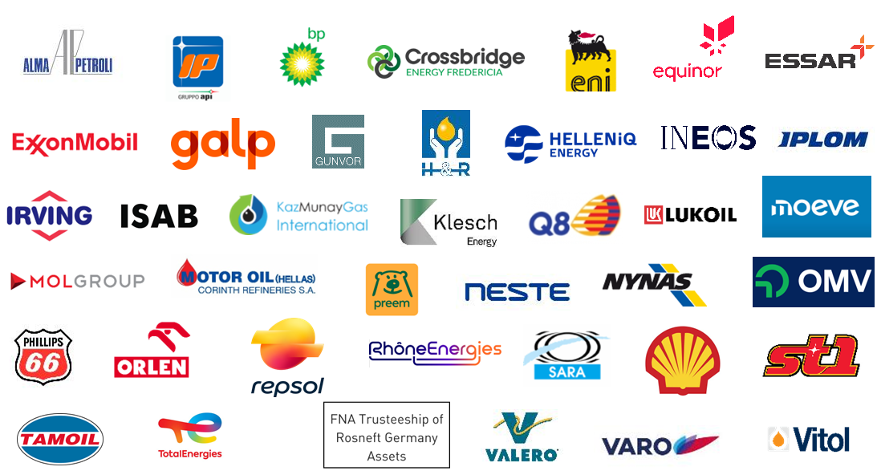



European Fuel Manufacturers Association
EU, UK, Switzerland and Norway | ≈95% of EU Refining
  Production & Distribution of liquid fuels, mobility products, feedstocks for industrial value chains, and related energy and raw materials.

Slide 5
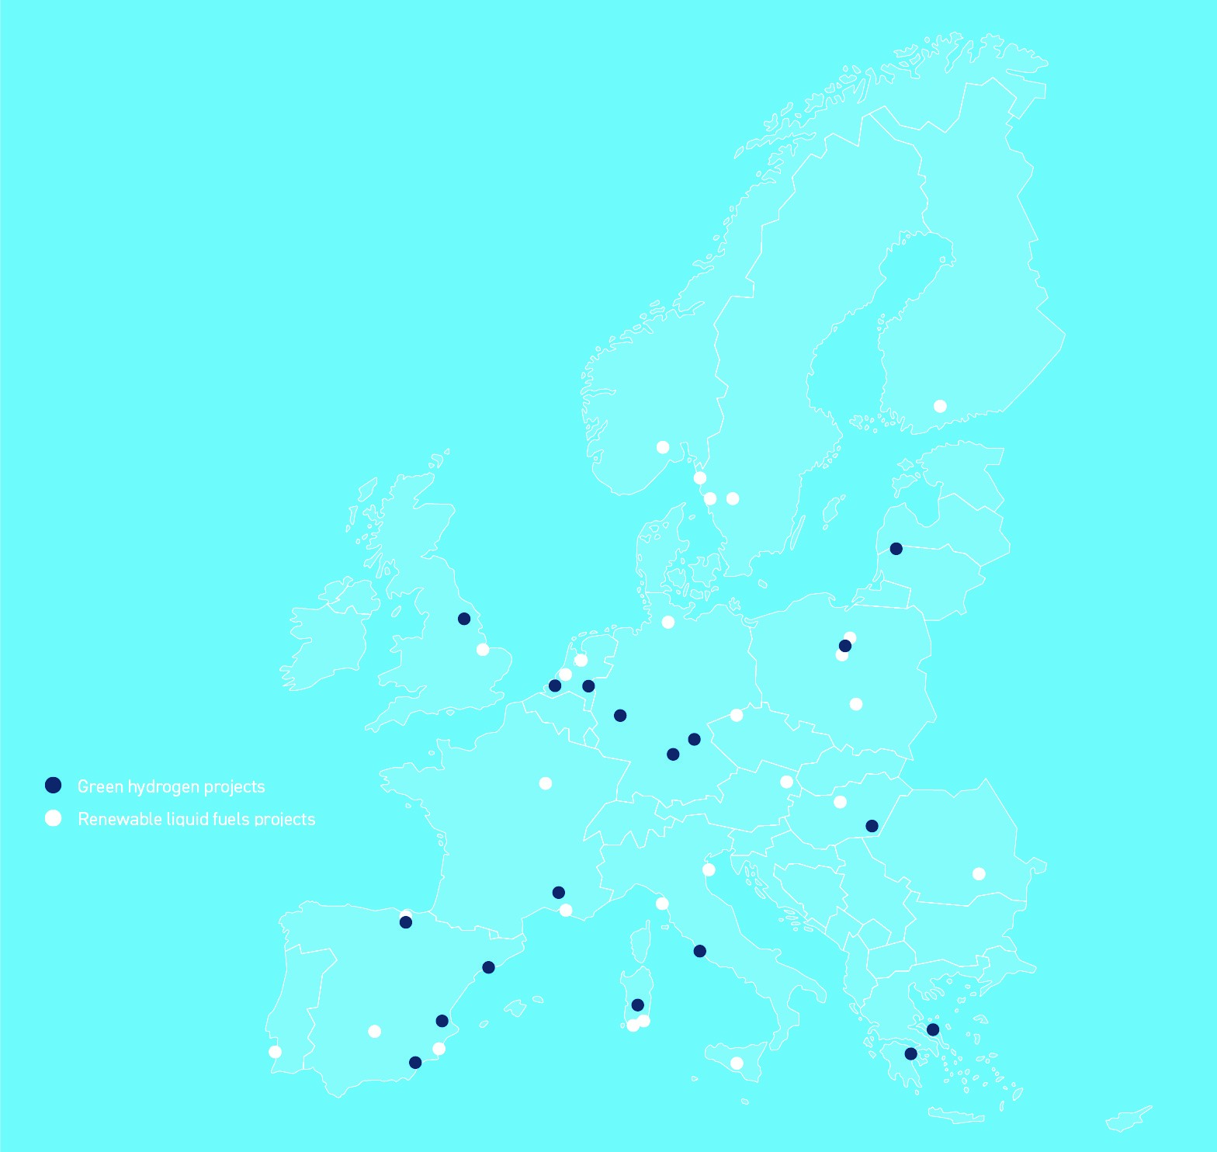
Our Sector Is Already Investing & Transforming
Clean Fuels & Energy Projects in Europe
of FuelsEurope’s Members
GREEN HYDROGEN
PROJECTS BEYOND FINAL INVESTEMENT DECISION (FID) 18 | FURTHER PROJECTS (PRE-FID) CURRENTLY ANNOUNCED 4
RENEWABLE LIQUID FUELS
PROJECTS BEYOND FINAL INVESTMENT DECISION (FID) SOME OPERATIONAL INCL. 27 | FURTHER PROJECTS (PRE-FID) CURRENTLY ANNOUNCED 10
Up to €400 Billion
INVESTEMENTS needed to convert existing refineries to biorefineries and e-refineries,
for the OVERALL TRANSITION by 2050

Slide 6
The Fuel manufacturing industry: a strategic asset that the EU cannot afford to lose
2

Slide 7
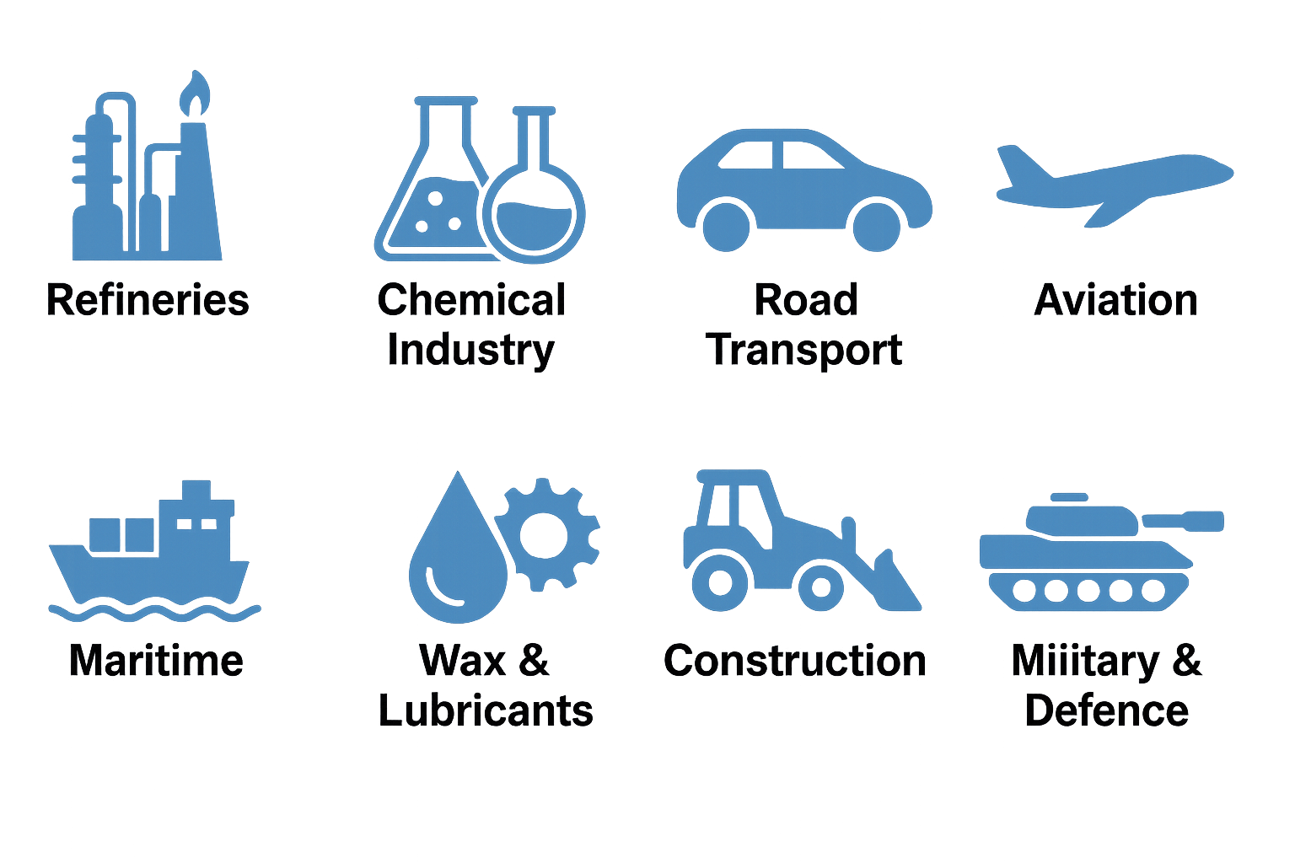

Strategic Reframing
Fuel Manufacturing industry not peripheral to EU’s industrial ecosystem, but it is foundational
Embedded in a broad value chain
Need to elevate the fuel manufacturing industry as strategic asset
  A non- recognition carries systemic costs : loss of domestic capacity would increase EU’s dependence on imports, heightening exposure to geopolitical risks + job losses and de-industrialisation.
Our decarbonisation is an indispensable prerequisite for the decarbonisation of other sectors.
Wake up call to policy makers: refinery closures represent an irreversible loss of industrial assets (35 refineries closed since 2009).
REFINING INDUSTRY
REFINING INDUSTRY
Construction & Agriculture
Refineries &
Biorefineries

Slide 8


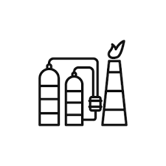
No transition without a viable industrial base
Refineries operate in a global and highly competitive market, Thus competitiveness is a precondition for both operational continuity and successful transformation
Policy choices must preserve Europe’s ability to manufacture, invest and enabling the transition without hollowing out industrial capacity.
EU’ industrial backbone depending on the refining industry is under significant strain
14,4 million vehicles in 2024, output declined by 6.2% year on year and volumes are still below pre-pandemic levels
9% of chemical production capacity is scheduled for closure, with more than 11 million tonnes of capacity announced for closures

Slide 9
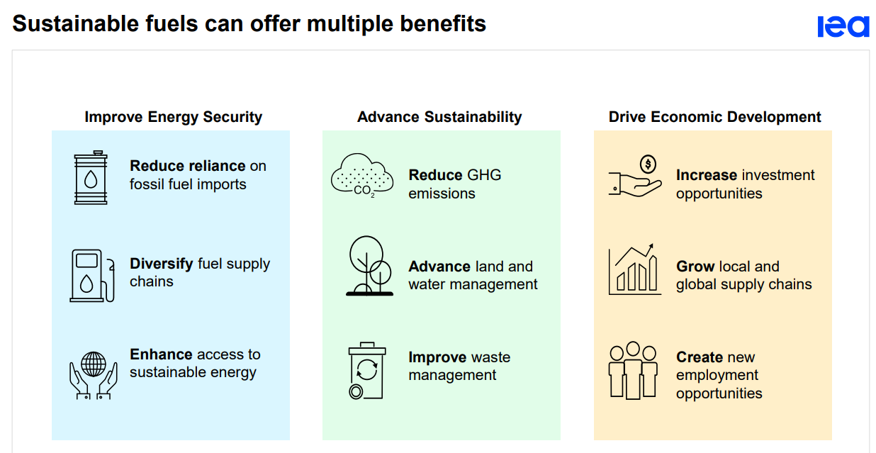
Conversion of existing assets and new manufacturing capacity
Converting existing assets is not just a cost-saving measure but a strategic imperative
  Neglecting to incorporate current refining capacity into the transition strategy would expose the EU to significant strategic risks.
The process of converting existing facilities and the rollout of new renewable capacity are complementary approaches that strengthen each other.
Achieving the scale of production needed requires rapid mobilisation of all available pathways.

Slide 10
Goal confirmed, not the trajectory
4
million tonnes of fuels (HEFA & HVO)
Transition in practice, not in theory
No challenge to the EU long term objective, but the trajectory and its pace - enabling conditions are currently insufficient.
Investments done over the past decade but beyond 2030 the transition enters a delicate phase
  Structural gaps persist:
      (WEF) only 10% of announced clean fuel capacity worldwide has reached the FID
      In EU many announced projects remain in “advance development” without FID .
  Why?
      Lack of business case – “exit decisions” most likely leading to closures and permanent loss of industrial capacity.
11 biorefineries in EU
Additional volumes – co-process
6,000+ fuel stations in EU

Slide 11
Conclusions
3

Slide 12
Conclusion : How a credible long-term transition looks like
Gradual
Pace of transition should be aligned with asset lifetimes, infrastructure turnover and investment cycles
Affordable
Avoid cost shocks for consumers and the industry
Synchronised
Technological development and regulatory mandates must evolve in a coordinated manner
Geopolitical conditions
Strategic importance of a strong EU production base
Creation of EU value chain for sustainable biomass

Slide 13
THANK YOU FOR YOUR ATTENTION
Emanuela.sardellitti@fuelseurope.eu
Advocacy Strategy Senior Executive

